Slide 1
Part 1 Introduction to Django
Version: 4.0.1
Written and design by: Babar ali

Slide 2
What is Django?
Django is a web application framework written in Python programming language.
The Django is very demanding due to its rapid development feature. It takes less time to build application after collecting client requirement.
By using Django, we can build web applications in very less time. Django is designed in such a manner that it handles much of configure things automatically, so we can focus on application development only.

Slide 3
Popularity Of Django
Instagram in Django
Mozilla Browser in Django
Pinterest in Django
Bit Bucket in Django
The Washington Time in Django

Slide 4
Feature Of Django
Rapid Development
Secure
Scalable
Versatile
Open Source
Fully loaded

Slide 5
How to download Python?
Before download the download you must download the Python in your PC.
Go to Official website of Python download it and Install in your pc:
www.python.org
Check if Python install in your PC or Laptop write in CMD.
shell
>>> python --version
>>> python
Check the version of Python
Enter the Python Shell

Slide 6
What is PIP?
Pip is a package manager system which is used to install and manage packages written in Python. For Python 3.4 and higher versions pip is used to manage packages.
Django requires pip to start installation.
To check PIP install in your PC or not write the following command in CMD.
shell
>>> pip --version
>>> python --version
Check the version of PIP
Check the version of Python

Slide 7
Some Basic command in CMD
shell
>>> cd desktop
>>> mkdir personal
>>> cd personal
>>> dir
>>> cd ..
Go to Desktop “cd” means current director
Create a Folder name “personal”
Go to personal folder
Show all the director with current directory
Go Back for one folder

Slide 8
How to Download / Install Django in Windows?
Django can be installed easily using pip.
In the command prompt, execute the following command: pip install Django. This will download and install Django.
shell
>>> pip install django
>>> django-admin --version
Download Django in this command
Check the version of Django or check if Django install in your PC or not.

Slide 9
Setup a Django Project
After you’ve successfully installed Django, you’re ready to create the scaffolding for your new web application. The Django framework distinguishes between projects and apps.
A Django project
Django project is a high-level unit of organization that contains logic that governs your whole web application. Each project can contain multiple apps.
A Django app
Django app is a lower-level unit of your web application. You can have zero to many apps in a project, and you’ll usually have at least one app.

Slide 10
Create Your First Django Project
With your virtual environment set up and activated and Django installed, you can now create a project. To create Django project write the following command.
shell
>>> django-admin startproject < your project name >
# Example to create project
>>> django-admin startproject my_site

Slide 11
How to Run Django project in Windows?
Access your project folder using “cd ”.
To run or activate Django project in windows run the following command.
shell
// Access Django project Folder
>>> cd my_site
// Run the Django Project
>>> python manage.py runserver
Go to the my_site folder
Run the Django Project

Slide 12
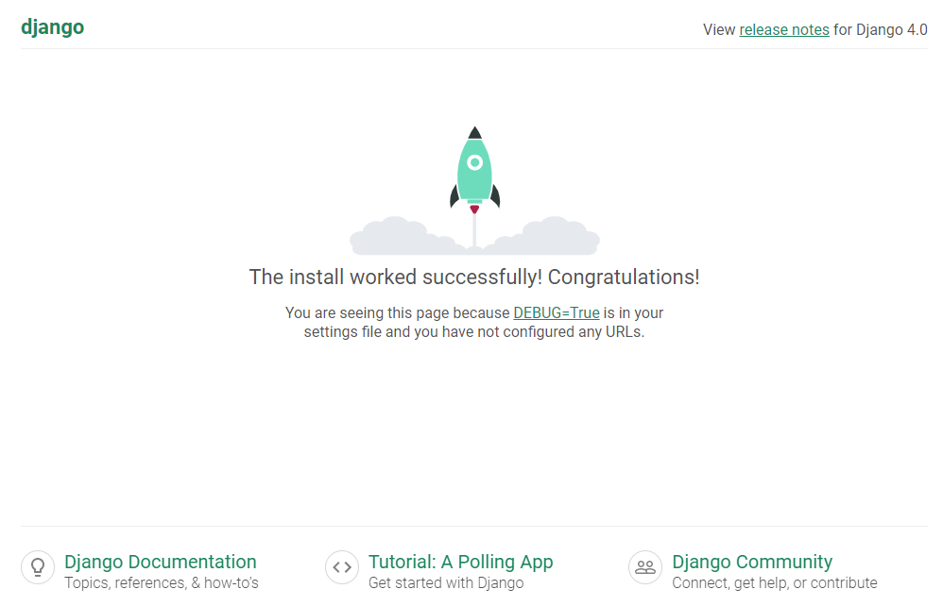
How your Project looks Like?

Slide 13
Thanks for Reading

